Slide 1
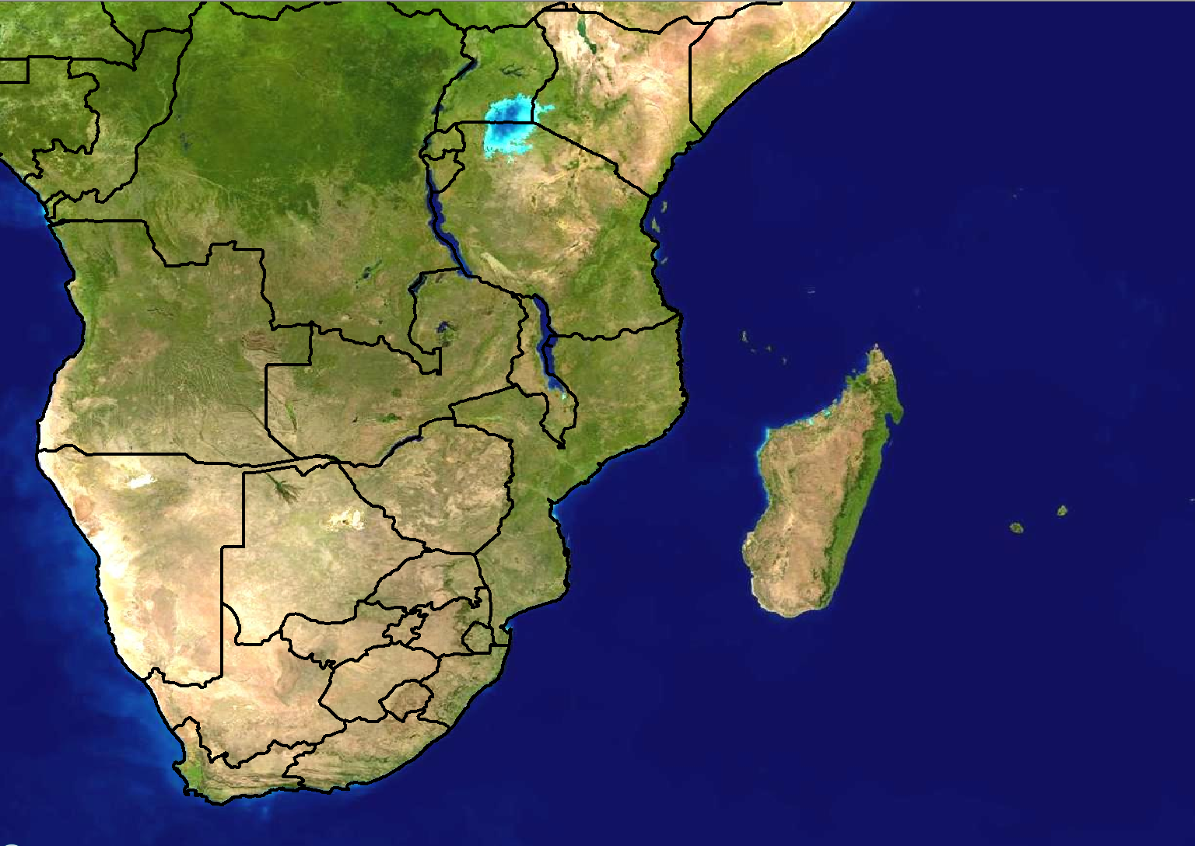
Scenario 1: Forecast for Day 3
24 hour rainfall (mm)
100
80
60
40
20
Forecast issued:
Monday 20 February
Forecast valid:
Wednesday 23 February

Slide 2
Scenario 1 - Additional information:
There is a weak tropical low pressure that is expected to be situated north of Madagascar on Wednesday
It does not seem to be very strong at this stage, possibly only reaching tropical depression stage
No forecast has been sent by RSMC La Reunion as yet, however NWP models are showing a large area of 30-40mm north and northwest of Madagascar in the next 24 hours, with a smaller zone of 80-100mm.

Slide 3
Scenario 2: Forecast for Day 1 (Today)
24 hour rainfall (mm)
>100
80
60
40
20
Forecast issued:
Wednesday 23 February Forecast valid:
Wednesday 23 February

Slide 4
Scenario 2 - Additional information:
Tropical low pressure has moved further to the southwest from what was initially expected
RSMC La Reunion sent a bulletin out yesterday and updated it today, classifying the low pressure as a tropical disturbance for today.
Models are in agreement with rainfall amounts of more than 80mm in 24 hours affecting southern islands of Seychelles, and more than 60mm the over some of the Comoros Islands
The Unified Model (12km) shows 6 hourly rainfall amounts of >50mm between 12-18Z today while Aladin shows 30-40mm during the same period.
An severe thunderstorm moved over Victoria / Moroni last night and there are reports of flooded roads

